Slide 1


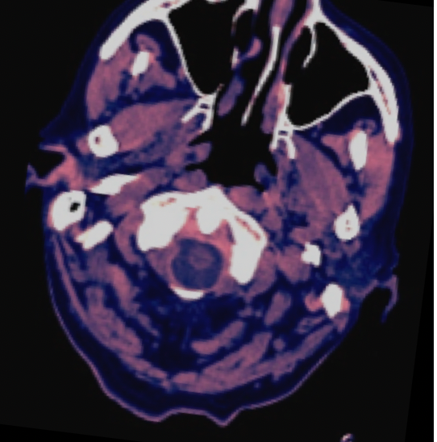
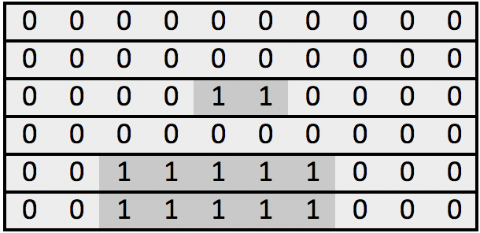
MRI Scan Sequence on Patient, Series, Study
Windowing:
> Brain
> Subdural
> Bone
Scipy ndimage
minimum_filter removes machine artifact
Augment hflip, vflip, transpose, shiftscale, brightness, resize-480 (albumentations)
Dicom
Files
2048 embedding
Bi-BLSTM
Extract for train and test pre-logit layer of dim 2048 for each epoch with TTA (Original, Hflip, Transpose)
Dense block 4096 X 4096
Bi-BLSTM
epidural
Intraparenchymal
Intraventricular
Subarachnoid
Subdural
any
Dense block 4096 X 4096
Sum LSTM & Dense layers
Linear layer
Classifier :
resnext101_32x8d_wsl
facebookresearch/WSL-Images
epidural
Intraparenchymal
Intraventricular
Subarachnoid
Subdural
any

